Slide 1

Multilingual Hate Speech Detection Using NLP
Submitted by: Devansh
E.No: E23CSEU0940 Natural Language Processing( CSET346)
Under the Guidance of:
Deepti Shakya

Slide 2

Problem Statement
Online content poses challenges for detection systems as
Rapid growth of toxic content
Multilingual usage increasing
Hinglish highly inconsistent
Traditional systems fail multilingual

Slide 3

Project Objectives
Detect hate speech accurately
Support multilingual inputs
Handle Hinglish variations
Compare different NLP models

Slide 4

Dataset
The project utilizes the
HASOC 2019 dataset + HASOC 2020 dataset
Which has English + Hindi data
Labelled as HOF vs NOT
TRAINING SET : 17,188 samples
TEST SET : 3,948 samples

Slide 5

System Pipeline
Processing Pipeline
Input text received
Text preprocessing applied
Optional normalization step
Model prediction generated
Result displayed

Slide 6

Preprocessing
Text Cleaning Steps
Convert text to lowercase
Remove URLs, mentions
Remove punctuation symbols
Normalize whitespace spacing

Slide 7

Normalization
Transliteration Normalization
Hinglish mapped to English
Fuzzy matching applied
Handles spelling variations
Improves model understanding

Slide 8
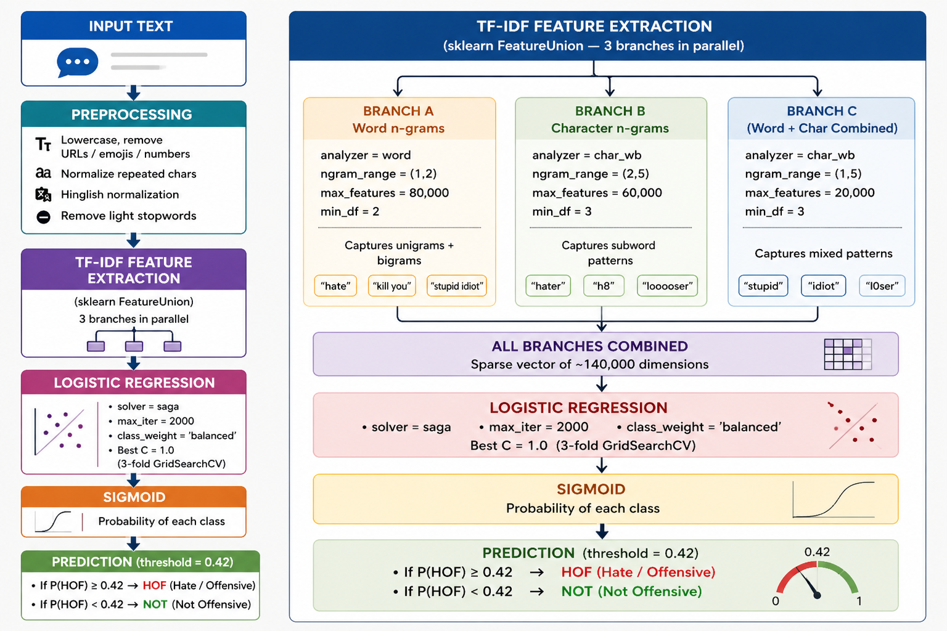
Models Used
Models Implemented
Logistic Regression Model
TF-IDF feature extraction
Word and char n-grams
Fast and efficient model
Strong baseline performance

Slide 9
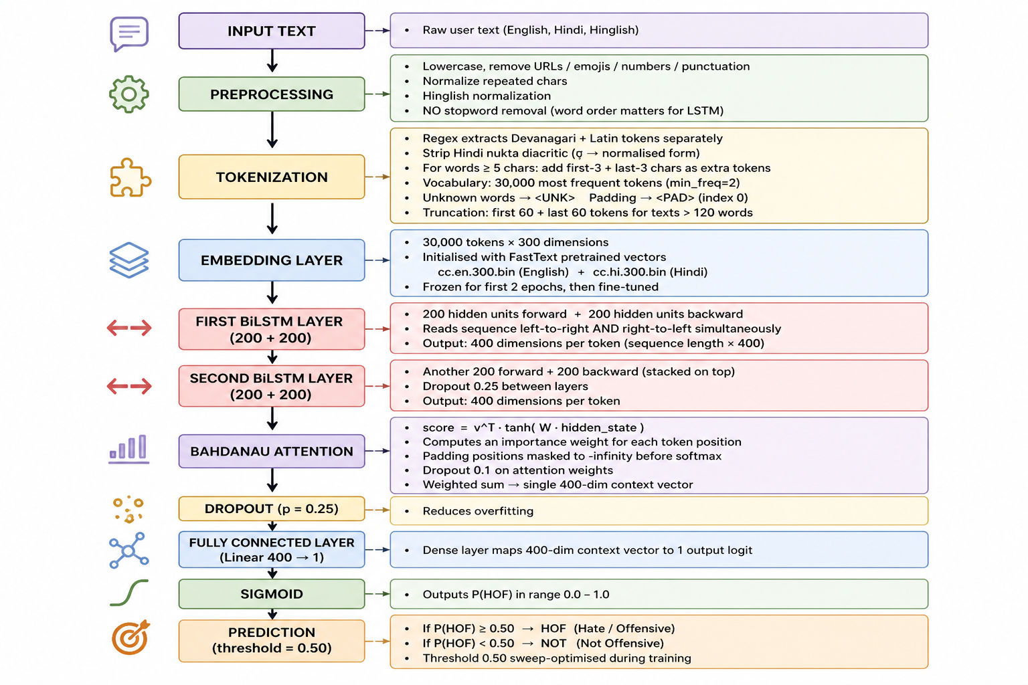
Models Used
LSTM Model
BiLSTM with Attention
Captures sequential context
Uses FASTTEXT embeddings
Handles complex patterns
Better contextual understanding

Slide 10
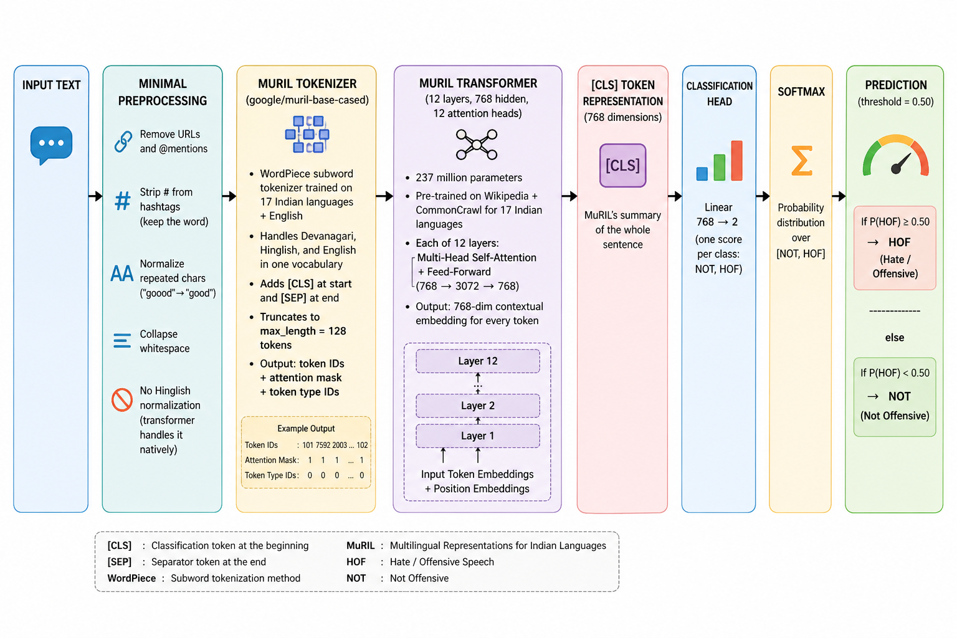
Models Used
MuRIL Model
Transformer Model (MuRIL)
Multilingual pretrained model
Handles Hinglish naturally
Uses subword tokenization
Best overall performance

Slide 11
Results
Metric | Logistic Regression (LR) | LSTM | MuRIL (Transformer)
Train Accuracy | 77.7 | 84.30 | 82.35
Validation Accuracy | - | 80.97 | 82.48
Test Accuracy | 81.66 | 80.57 | 82.35
Precision/Recall(Macro) | 80.64/80.47 | 80.53/77.66 | 81.15/80.59
F1-Score(Macro) | 0.8055 | ~0.7856 | 0.8085

Slide 12
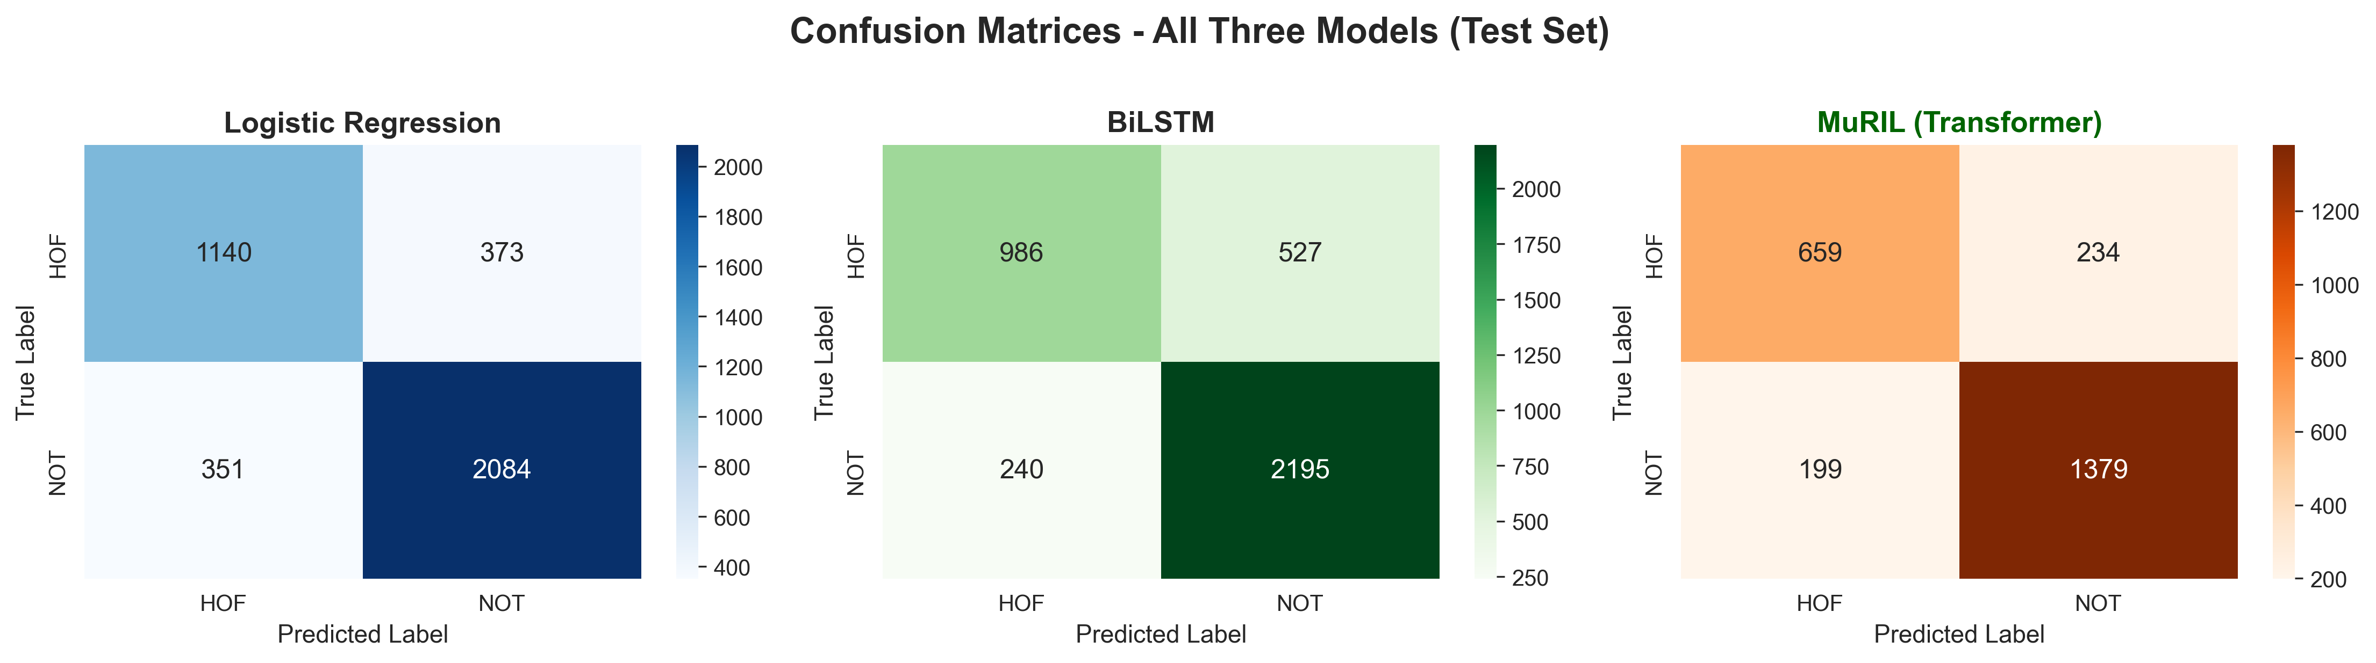
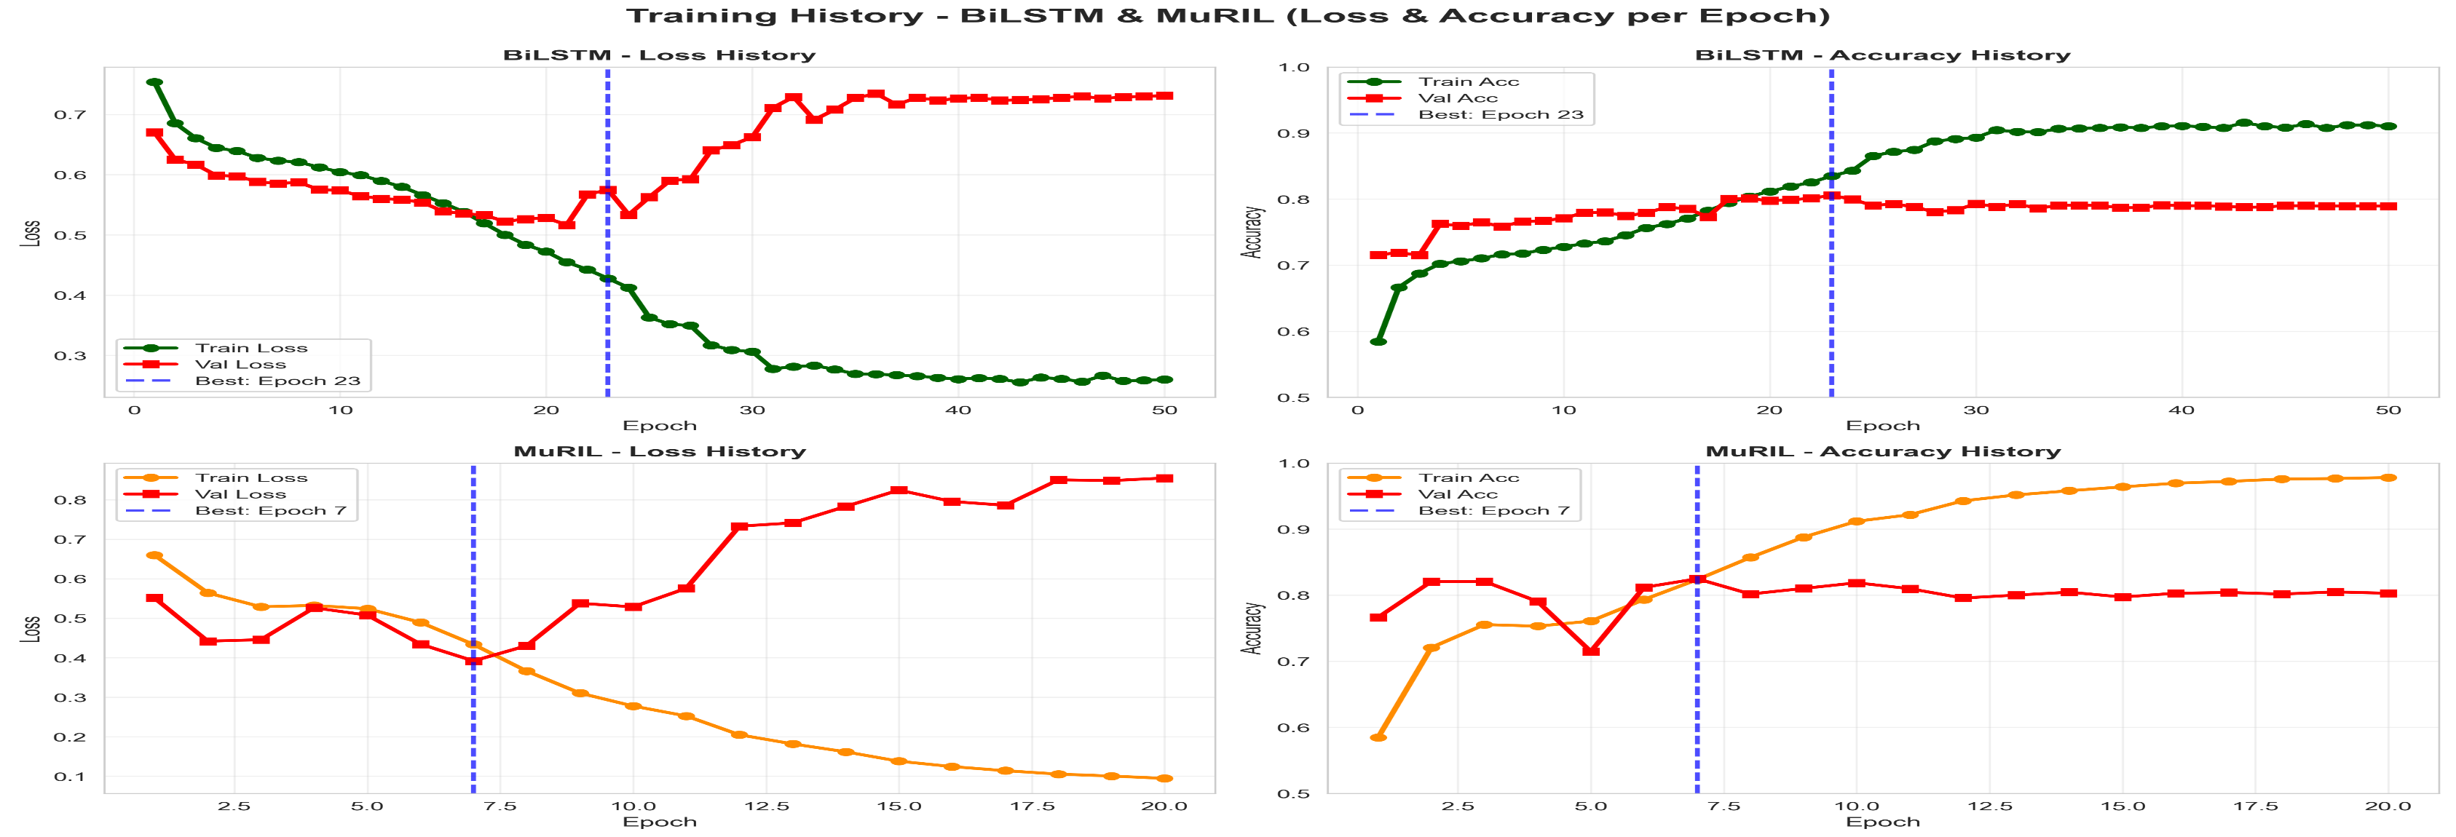

Slide 13
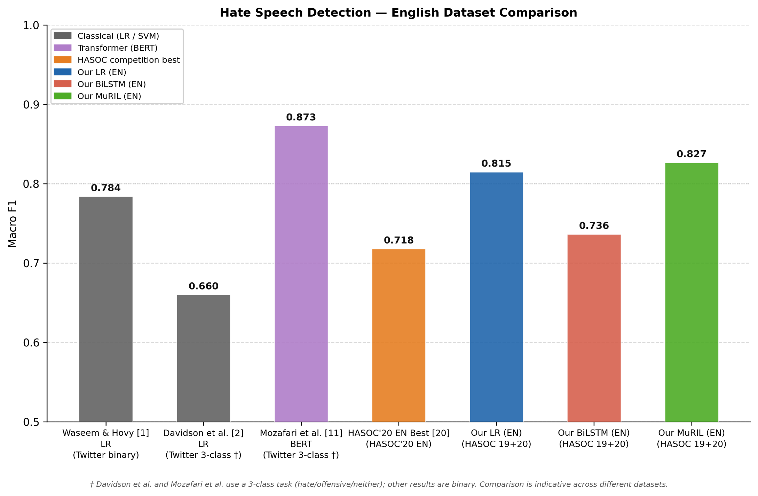
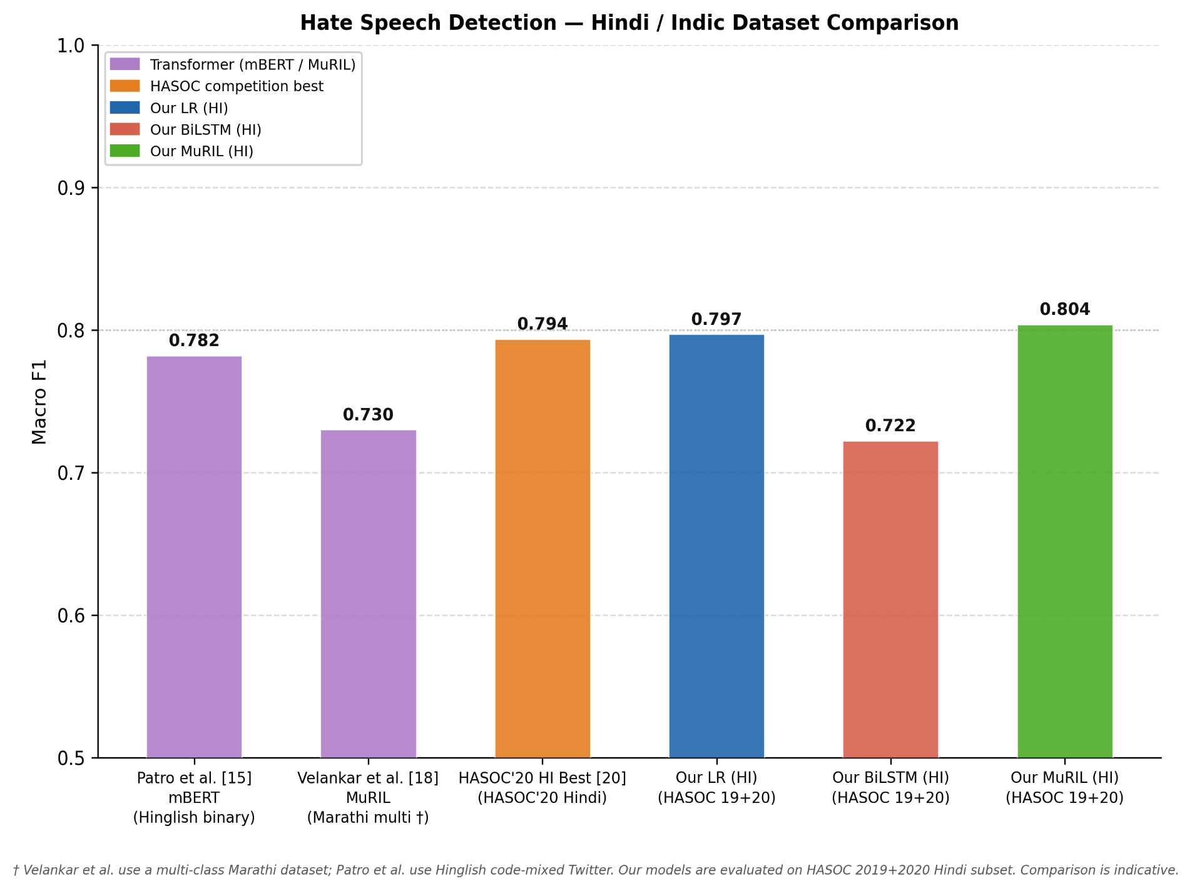
Comparisons
Comparison of hate speech detection models on English datasets. Classical models (Logistic Regression) and transformer-based approaches (BERT) are compared with the proposed models. The proposed MuRIL model achieves competitive performance (Macro F1 = 0.8266), outperforming traditional baselines and HASOC competition results. Note: Some prior works use a 3-class classification setup (†), while others use binary classification; comparisons are therefore indicative
Performance comparison on Hindi and code-mixed (Indic) datasets. The proposed MuRIL model achieves the highest performance among com- pared Indic models (Macro F1 = 0.8037), outperforming approaches such as mBERT and the HASOC 2020 competition best system . This highlights the effectiveness of transformer-based models for multilingual and code-mixed text. Note: Velankar et al. [18] use a multi-class Marathi dataset, and Patro et al. use Hinglish Twitter data; comparisons are indicative

Slide 14
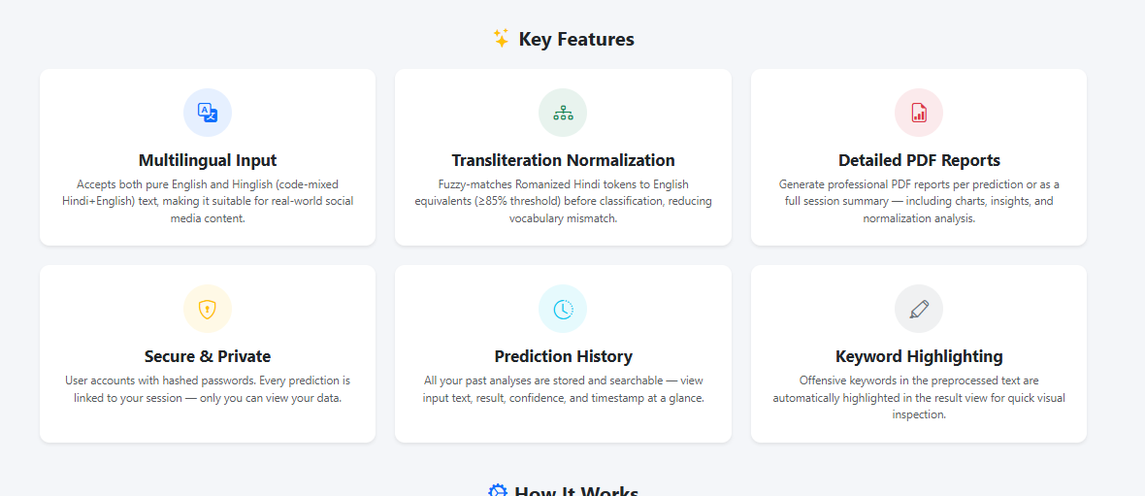
System Features
Web Application Features
User login and authentication
Real-time text prediction
History tracking system
PDF report generation

Slide 15
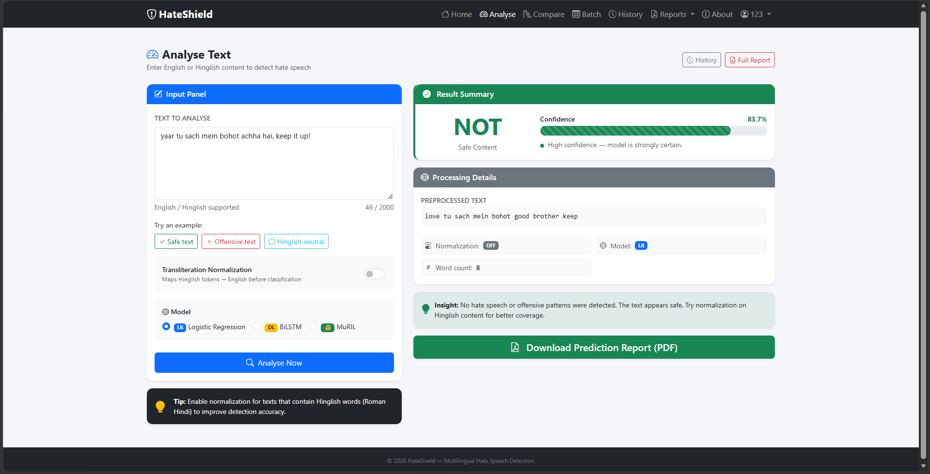
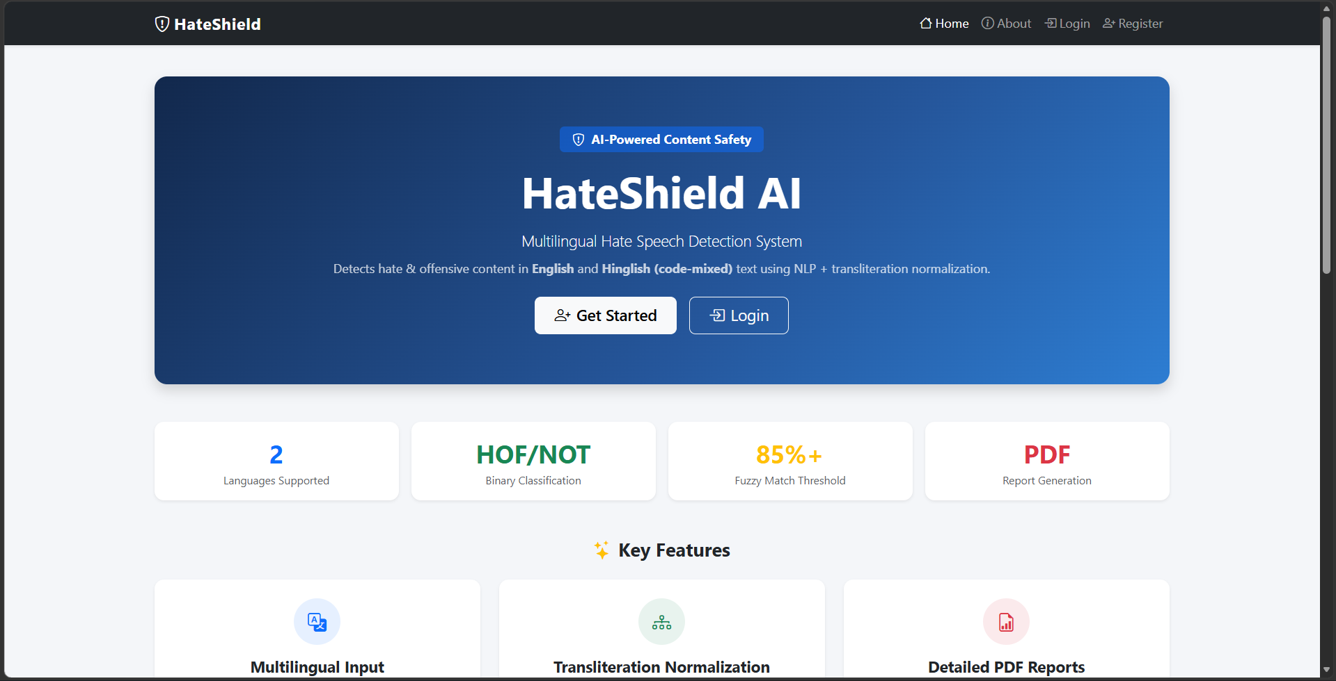
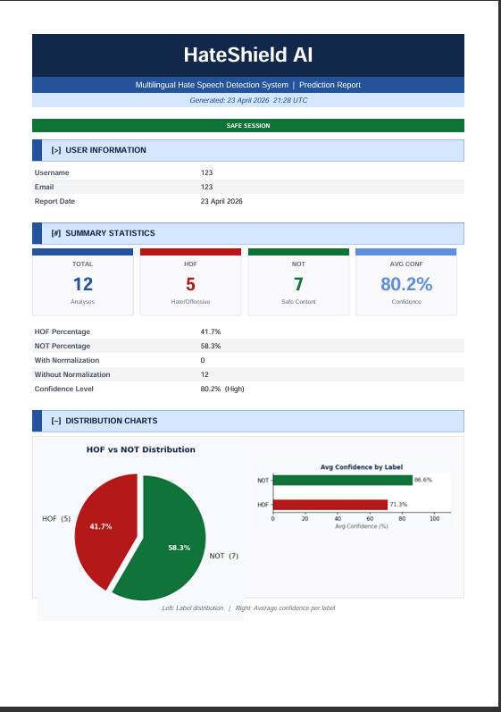
WEBSITE –
Try here!!
HateShield – Multilingual Hate Speech Detection

Slide 16
Challenges
Hinglish spelling variations
Dataset imbalance issues
Model deployment constraints
Less Accuracy achieved

Slide 17
Future Work
Future Improvements
Larger multilingual datasets
More Accurate and robust
Better normalization techniques
Real-time moderation systems
Mobile application integration

Slide 18
Conclusion
Medium hate speech detection achieved
Multilingual handling improved significantly
Comparative model analysis completed
Beginner web system implemented

